Slide 1
Geology Quiz Review

Slide 2
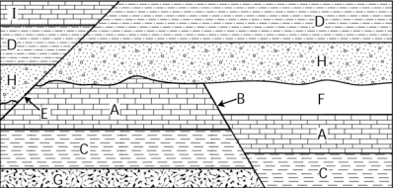
Warm Up
Arrange the rocks and fault in this puzzle from oldest to youngest.
This is an example of what type of dating?

Slide 3
Let’s Review
3.1 Minerals
The characteristics of a mineral (S.N.I.F.C)
3.2 Indentifying Minerals
7 ways to indentify a mineral

Slide 4
3.3 Rock Cycle
What is a rock? How is it different than a mineral?
What are the three main types of rock?*
Ways in which one rock can turn into another
3.4 Relative Dating
Principle of Superposition
Rock Puzzles

Slide 5
3.5 Absolute Dating
Radiometric dating methods
Calculating Half Life

