Slide 2
Warm Up
What are the two types of active transport?
How is active transport different from passive transport (2 ways)

Slide 3
Warm Up
What is the name of the organelle that captures energy from the sun?
What color is this organelle?
Is this organelle found in plant or animal cells?

Slide 4
Objective
Students will be able too…
Describe the process of Photosynthesis
Explain how Photosynthesis and Cellular Respiration are related.

Slide 5
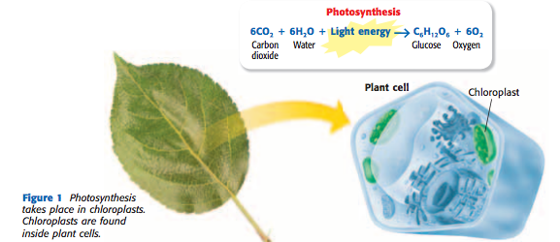
What is Photosynthesis?
Photosynthesis is the process which plants capture energy from the sun to make food.

Slide 6
How does this happen?
Chlorophyll in chloroplasts traps the energy from the sun. Then, plants use the energy captured by chlorophyll to change carbon dioxide and water into food for the plant.
The food that the plant produces is called glucose, which is a a carbohydrate that the cell can use for energy. Photosynthesis also produces oxygen

Slide 7
The formula for photosynthesis is

Slide 8
How do animals get energy?
Animal cells cannot produce their own food like plant cells. Animal cells use a process called cellular respiration in order to get energy from food.

Slide 9
Cellular Respiration is the process by which cells use oxygen to produce energy from food.
Many cells can get energy without using oxygen through a process called fermentation
In cellular respiration carbon dioxide & water are produced

Slide 10
The formula for Cellular Respiration is

Slide 11
Visual Aids
NOVA Animation
Phototsynthesis Video

Slide 12
Exit Slip

